Slide 1


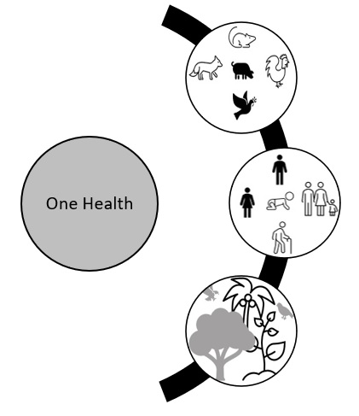
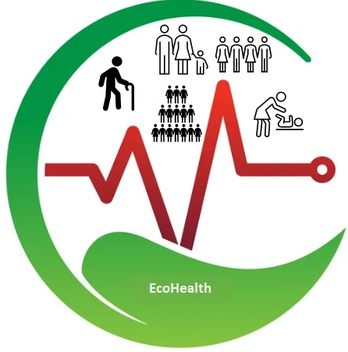








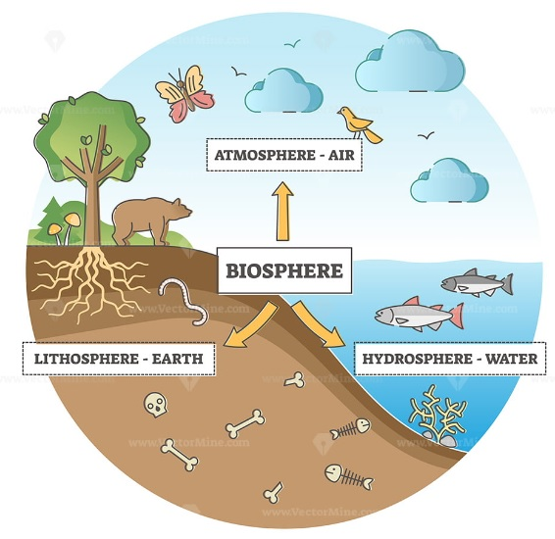

Human Activities
Earth's Systems
Planetary Health
Human Health

Slide 2
One Health

Slide 3






EcoHealth

Slide 4


Slide 5
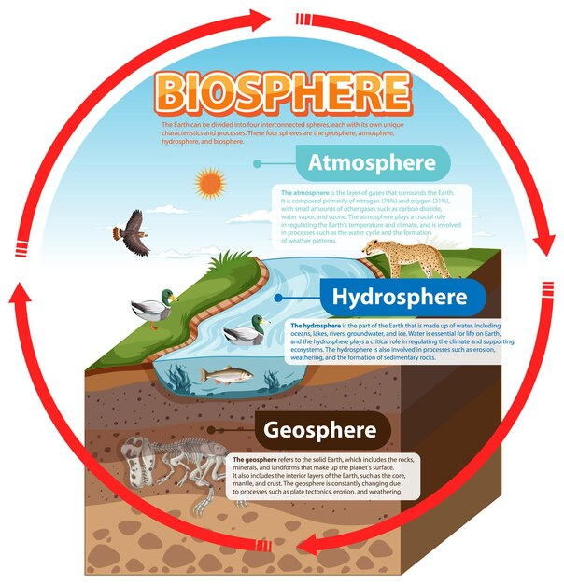

Slide 7
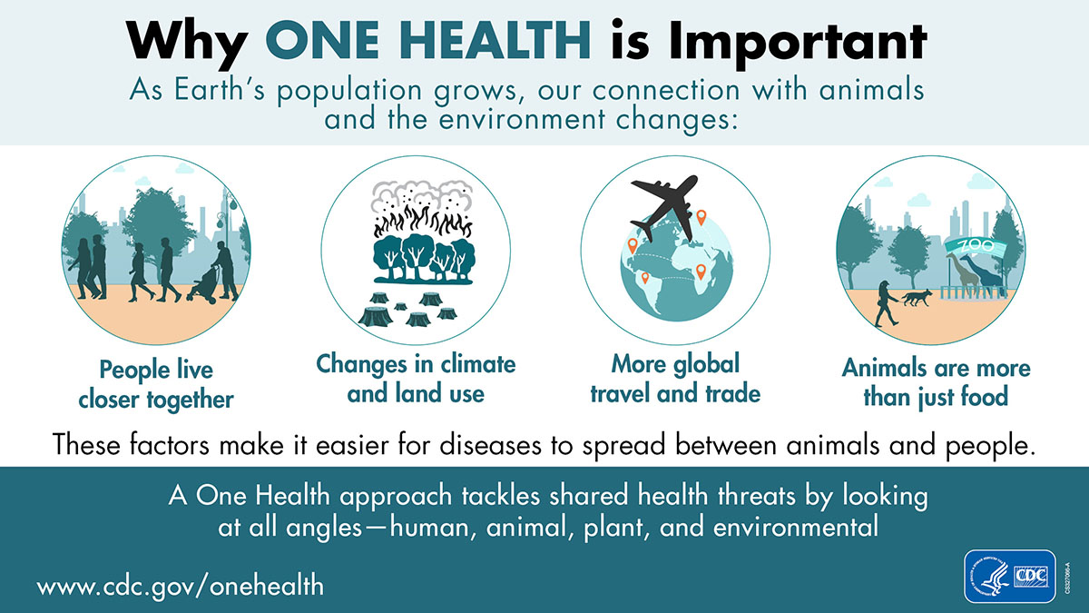

Slide 8











One Health
Human Health
One Health
Animal Health
Environmental Health

Slide 9

Eco HealthEcoHealth “is an approach that integrates natural and social sciences to understand and manage ecosystems and the interactions among human, animal, and environmental health
Human Health
Animal Health
Environmental Health
Eco Health

Slide 10


















Planetary Health Planetary Health “is the achievement of the highest attainable standard of health, well-being, and equity worldwide through judicious attention to the human systems—political, economic, and social—that shape the future of humanity and the Earth’s natural systems that define the safe environmental limits within which humanity can flourish
Human Health
Planetary Health
Human Systems
Earth Systems
Biosphere

